Slide 1
Lesson #7
Making Decisions!

Slide 2
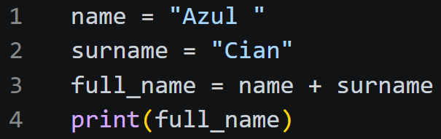
Up to now, our code has been “sequential”
(It just means “drawing where the code goes!”)
This is a CFG (Control Flow Graph)
Ln 1
name = “Azul “
Ln 2
surname = “Cian“
Ln 3
full_name = “Azul Cian“
Ln 4
print(“Azul Cian”)
Output:
Azul Cian

Slide 3
Do you remember the Turing Machine?
It has…
2 instructions
2 decisions

Slide 4
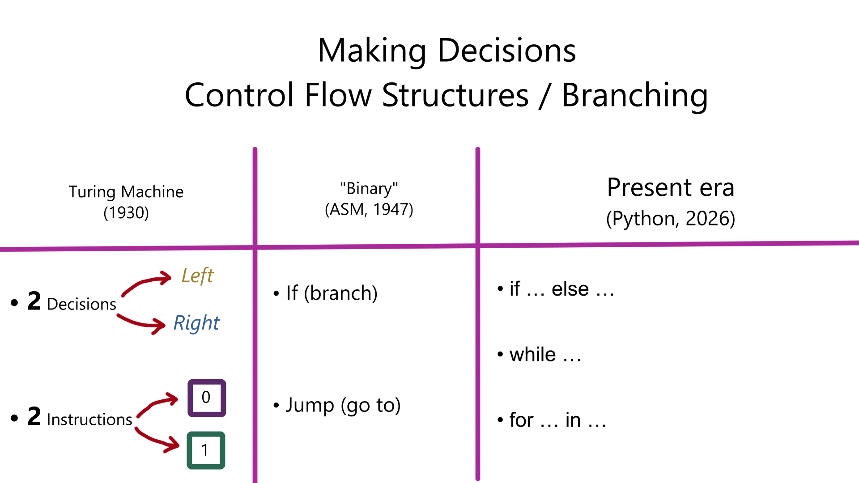
range(a, b, c)

Slide 5
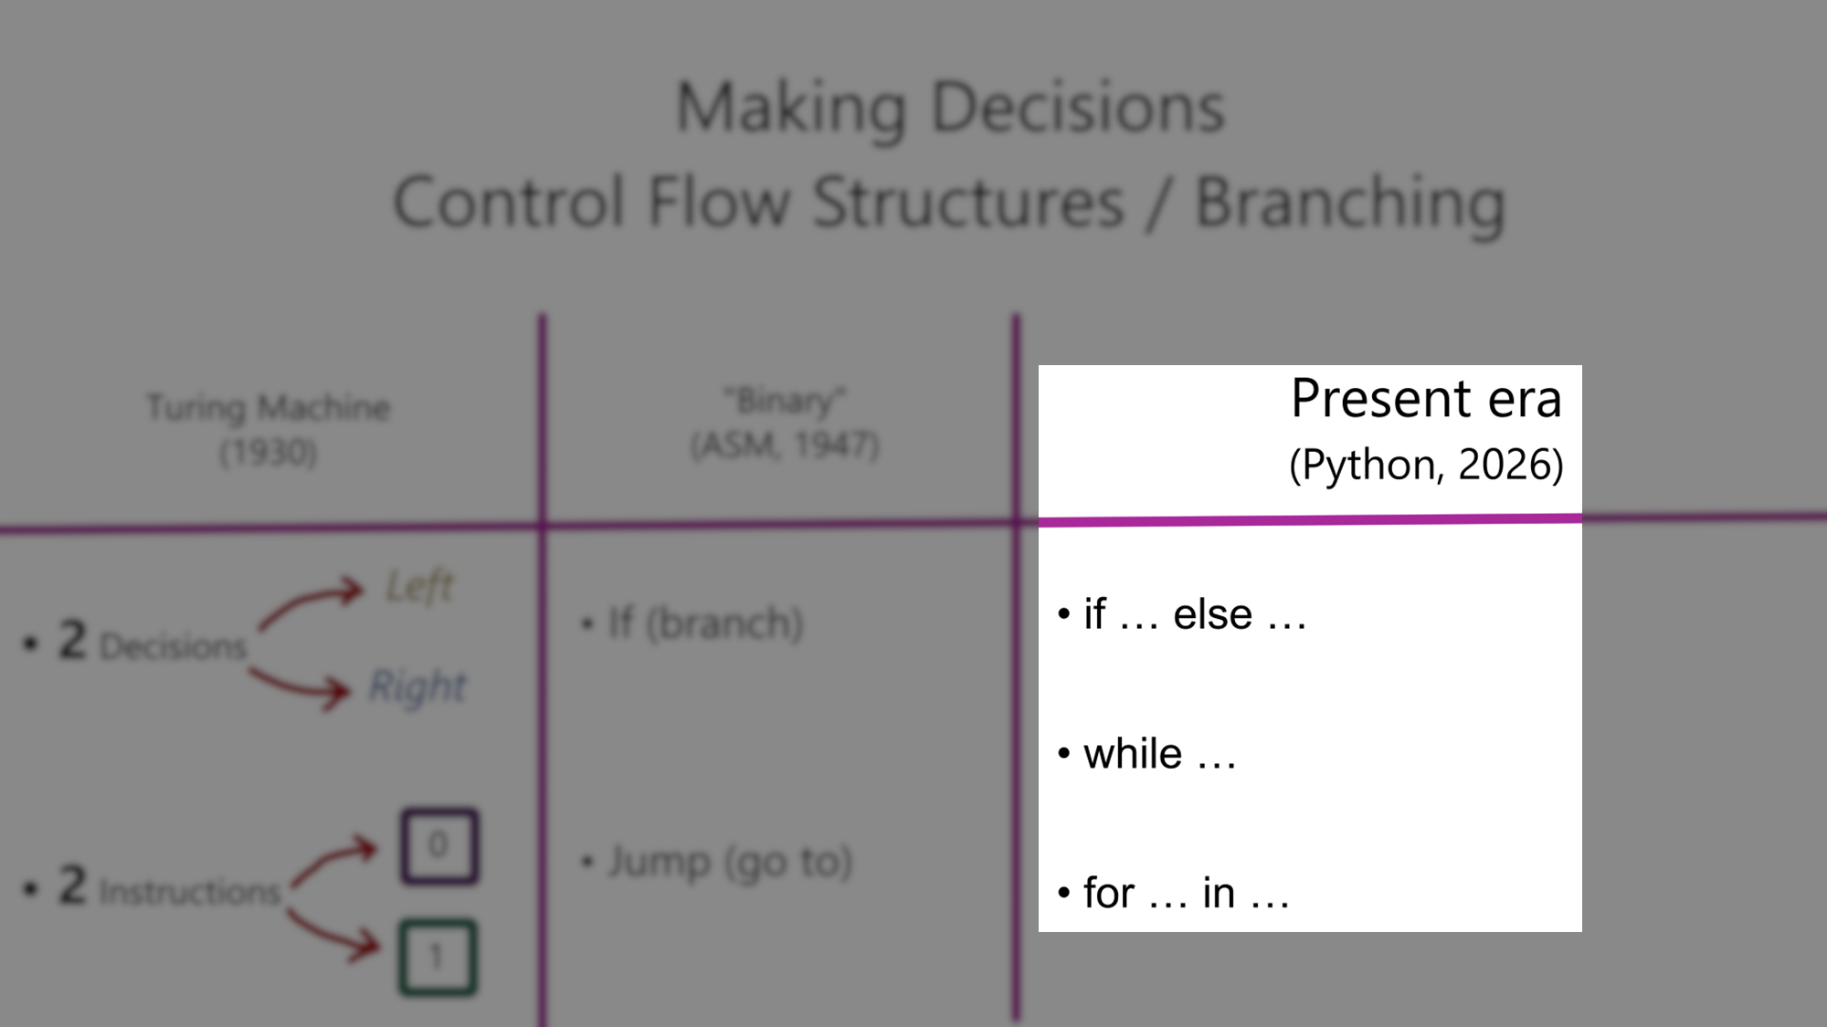
range(a, b, c)

Slide 6
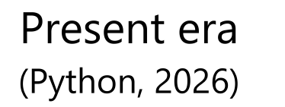
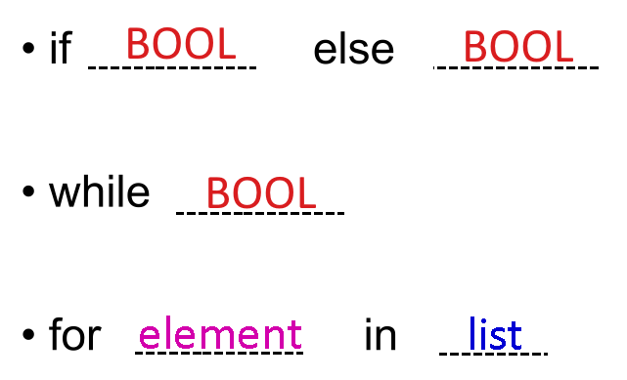
index
range(a, b, c)

Slide 7
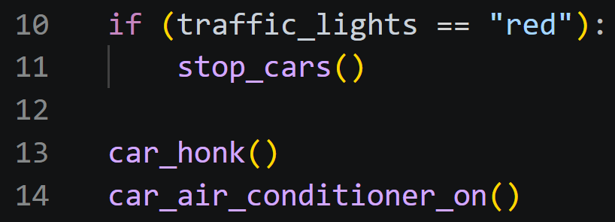
If (branch)
Ln 1
Are the traffic lights red?
False (No)
True (Yes)
Ln 3
Stop the car
Ln 4
Honk
Ln 5
Turn on air conditioning

Slide 8
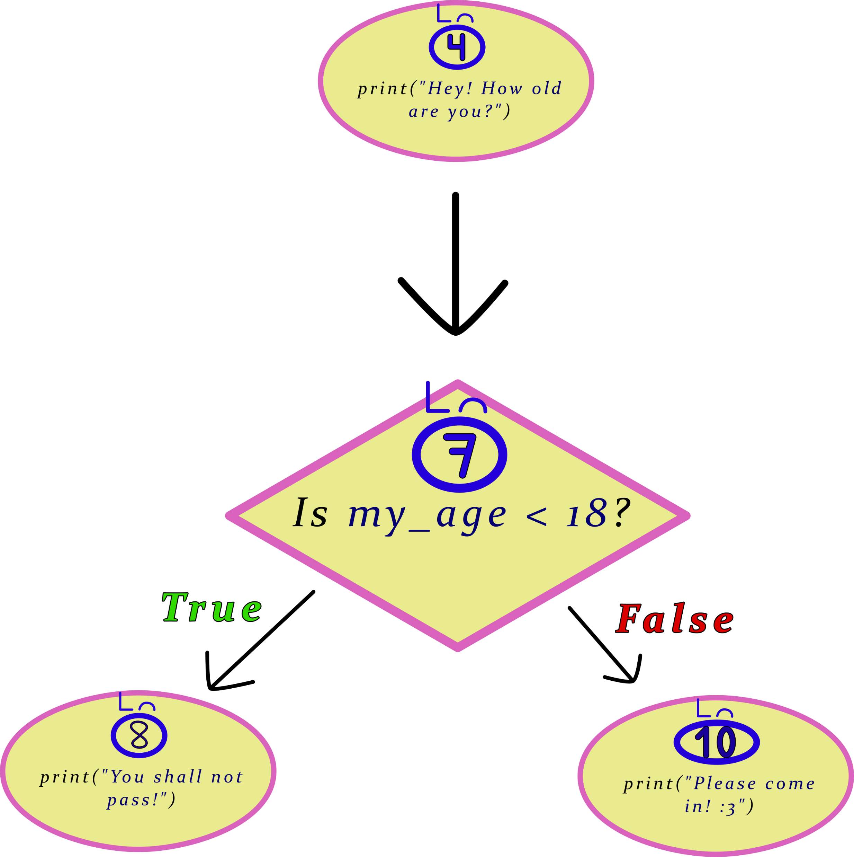
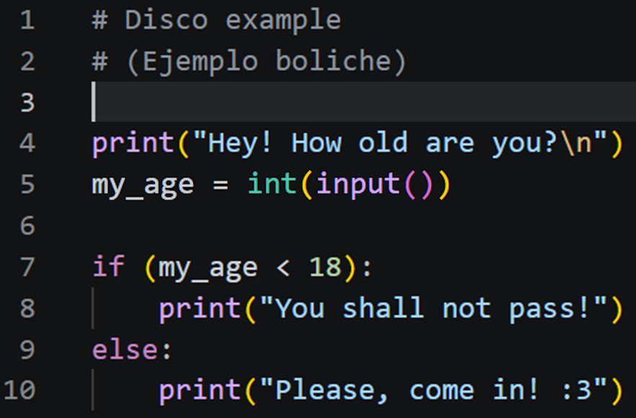
If else (branch)

Slide 9
If elif elif elif elif… else
Etc.
Etc.

Slide 10
It’s very easy to get lost… right?
If you get lost when coding, do your own drawings on pen and paper!

Slide 11

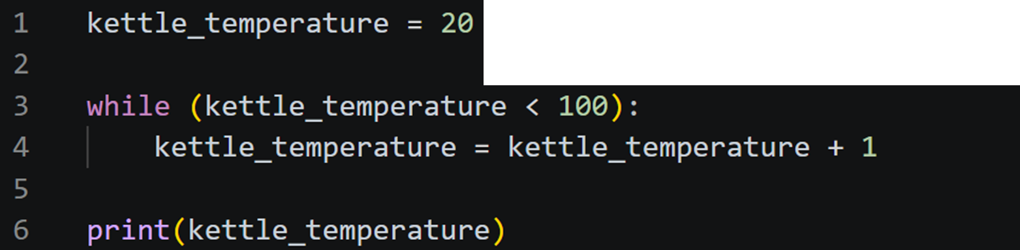
While (loop)
Ln 1
kettle_temperature = 20
Ln 3
Ln 4
is kettle_temperature < 100?
kettle_temperature = kettle_temperature + 1
F
T
Ln 6
print(kettle_temperature)

Slide 13
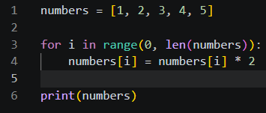
Ln 1
For ____ in range(a, b, c) (loop)
numbers = [1, 2, 3, 4, 5]
Ln 3
Ln 4
Double the number
is number in numbers?
F
T
Ln 6
print(numbers_times_two)

Slide 14
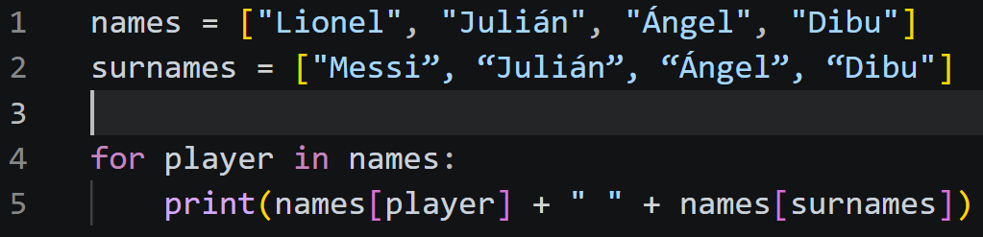
Ln 1
For ____ in range(a, b, c) (loop)
names = [“Lionel ”, “Julián ”, “Ángel ”, “Dibu “]
Ln 2
surnames = [“Messi”, “Julián”, “Ángel”, “Dibu”]
F
T
Ln 5
print(…)

Slide 15
Ln 1
For ____ in range(a, b, c) (loop)
names = [“Lionel ”, “Julián ”, “Ángel ”, “Dibu “]
Ln 2
surnames = [“Messi”, “Julián”, “Ángel”, “Dibu”]
F
T
Ln 5
print(…)

Slide 16
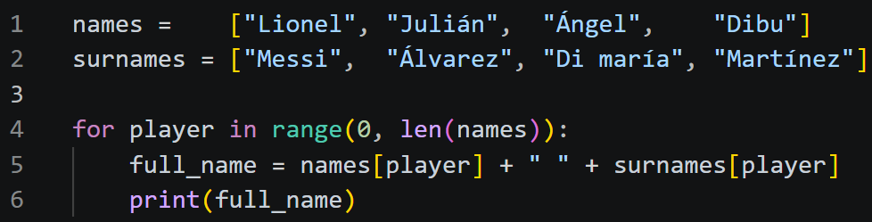
For ____ in range(a, b, c) (loop)
Ln 1
names = [“Lionel ”, “Julián ”, “Ángel ”, “Dibu “]
Ln 2
surnames = [“Messi”, “Julián”, “Ángel”, “Dibu”]
Ln 6
Ln 4
full_name = names[player] + “ “ + surnames[player]
Is player between 0 and len(names)?
Ln 5
F
print(full_name)
T
Ln 7
Ln 8
…

Slide 17
len(names) == 4
len(surnames) == 4
What would happen if
len(names) != len(surnames)?

